Slide 1
Common Attack In Modern Web Apps
Easy Topic
Easy To Implement
Easy To Understand

Slide 2
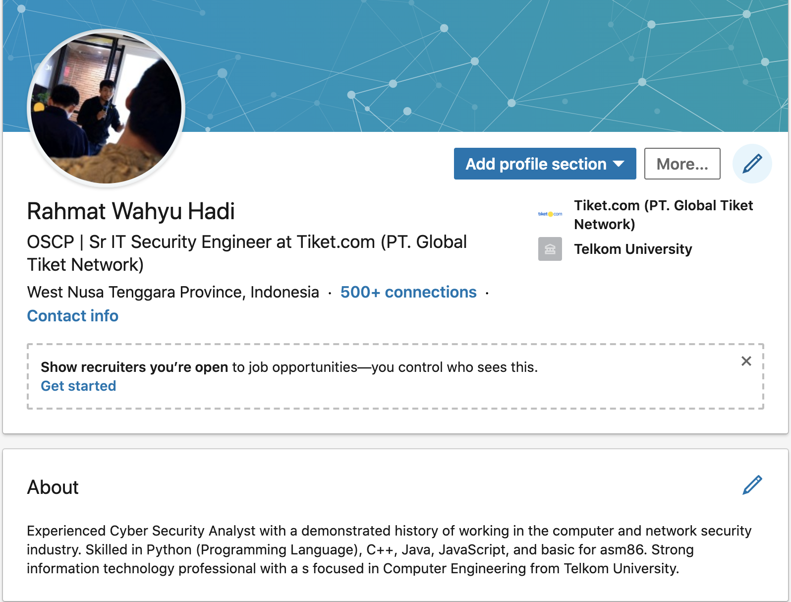
- Red Team and Automation - Pentester - Offensive Security Certified Professional
Jakarta Pusat, Kebon Kacang
hrahmatwahyu@gmail.com
@r.wahyu (telegram)

Slide 3
Today Challenge with Application Security

Slide 4

22 M
Software Developers around the world
~Evans Data

Slide 5
111 Billions Lines of code written by developers every year
~ CSO Online

Slide 6
1 to 4 Exploitable Security bugs in every 50.000 Lines of codes ~StackOverflow

Slide 7
21 % Of data Breaches caused by software vulnerability
~ Verizon

Slide 8
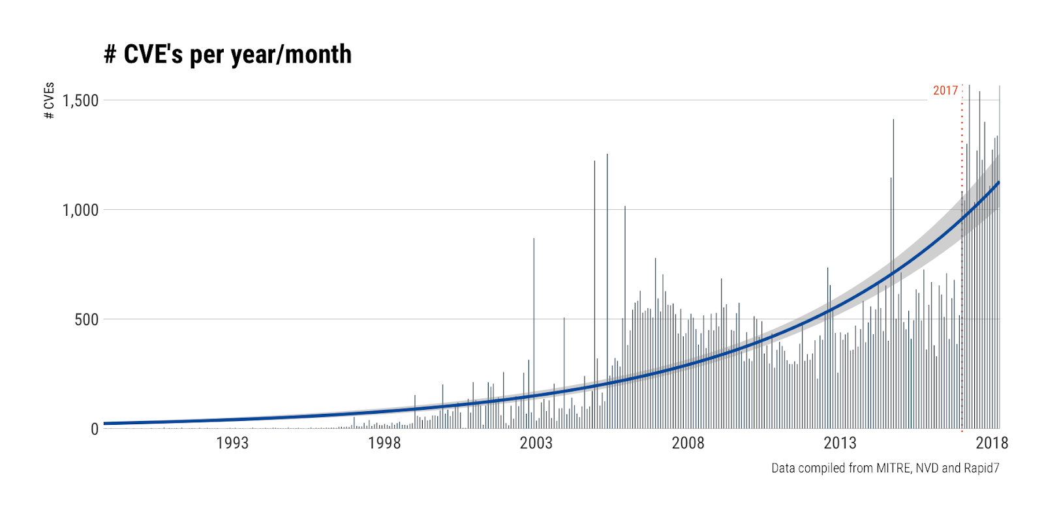

Slide 9
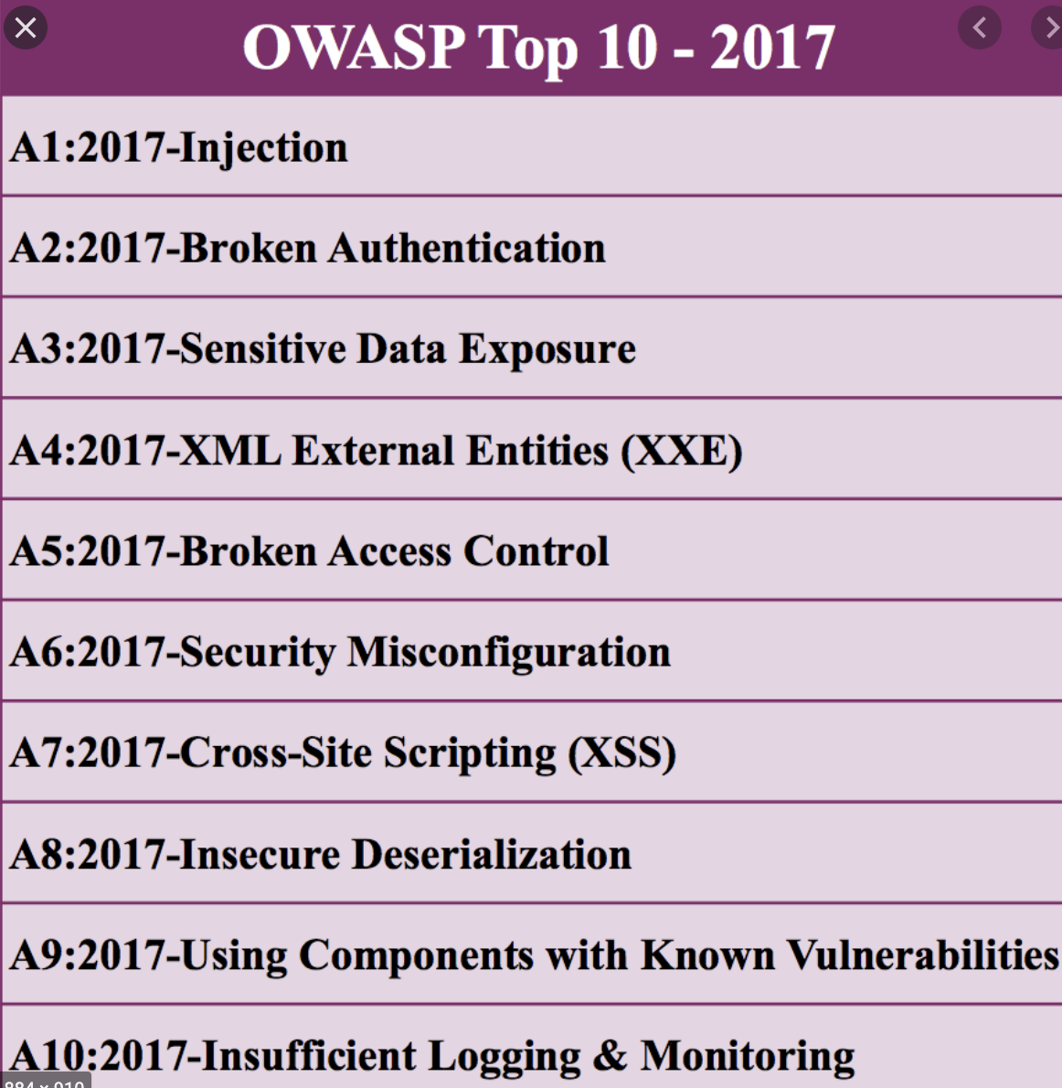
OWASP

Slide 10
Real Case

Slide 11
Account Take Over (ATO)
PHP type juggling
Bypass OTP
Bad Login Design Flow

Slide 12
Php type juggling
PHP has a feature called “type juggling”, or “type coercion”. This means that during the comparison of variables of different types, PHP will first convert them to a common, comparable type.

Slide 13
Php type juggling
…..
if ($_POST["password"] == ”Admin_P4sswD”) {
login_as_admin();
}

Slide 14
Php type juggling
Then, simply submitting an integer input of 0 would successfully lo
you in as admin, since this will evaluate to True
(0 == “Admin_P4sswD”) -> True
And “0” and “Admin_P4sswD” are, obviously, different strings.
(“0” == “Admin_P4sswD”) -> False

Slide 15
Bypass OTP (One Time Password)
No Rate Limit

Slide 16
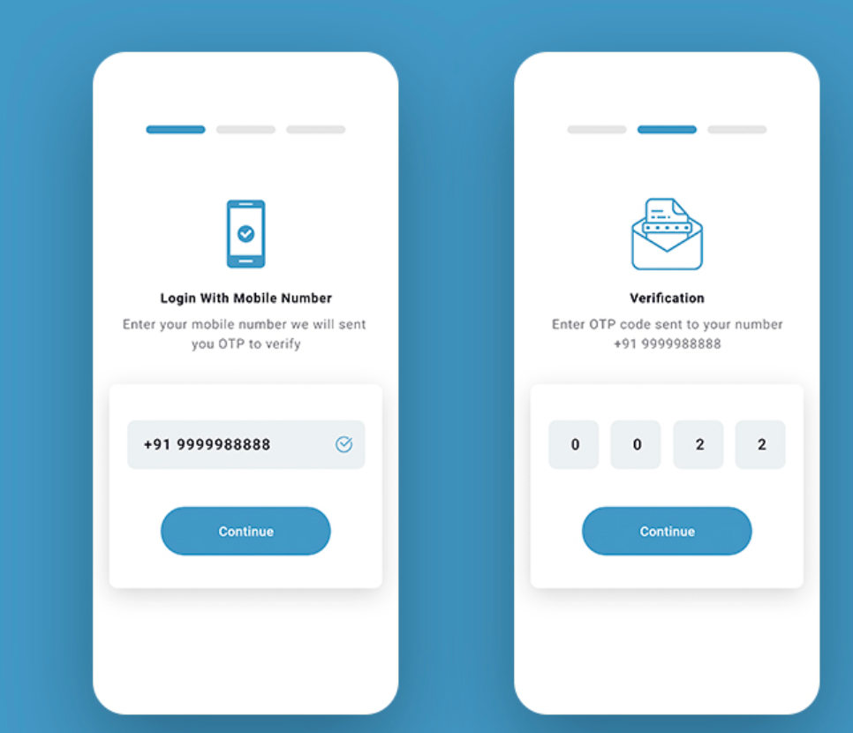

Slide 17
Bypass OTP (One Time Password)
Array Object Format

Slide 18
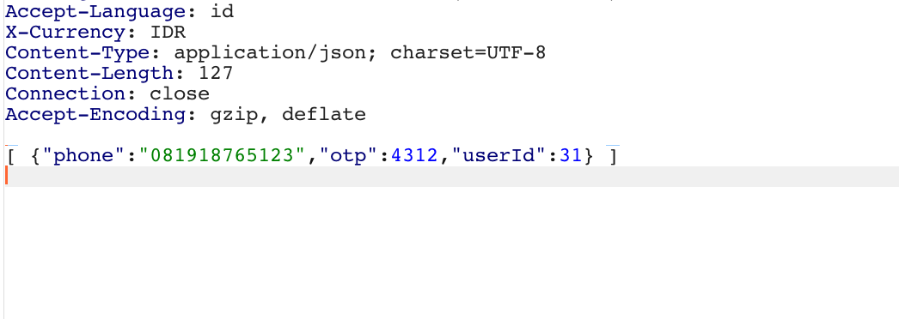
Bypass OTP (One Time Password)

Slide 19
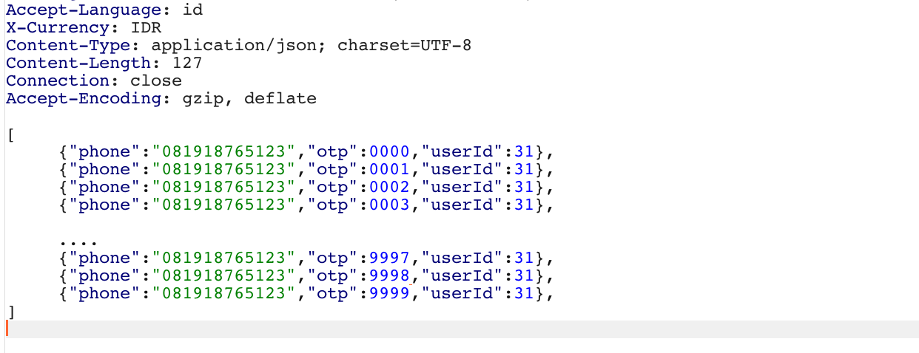
Bypass OTP (One Time Password)

Slide 20
Bypass OTP (One Time Password)
Use another user OTP

Slide 21
Example Case
- Attacker has an account with a mobile phone number: 081917917917
- The attacker will take over the account from the owner named Bob with phone 081918918918

Slide 22


/api/login
{“phone” : “081917917917”}
Atacker : 081917917917
Send OTP example : 4312

Slide 23
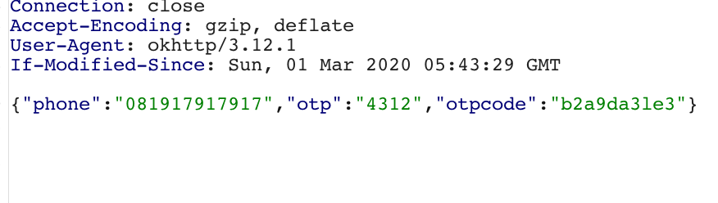
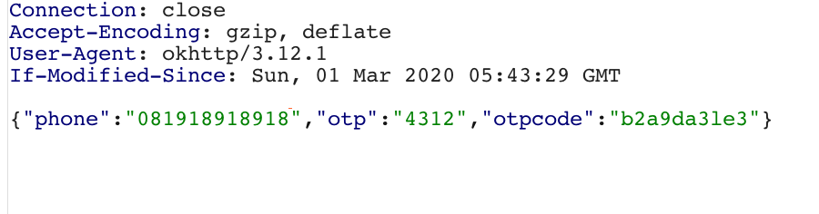
Normal Request
Change Phone Number

Slide 24
Insecure Direct Object Reference (IDOR)
Insecure direct object references (IDOR) are a type of access control vulnerability that arises when an application uses user-supplied input to access objects directly
https://portswigger.net/web-security/access-control/idor

Slide 25

Example /user_id=xxxxx
user_id : 120
Name : Budi
Address : Jakarta
Phone : 6298121
ID : xxxxx
NPWP : xxxxxx
Get My user profile which user_id is 120 please !
Here your profile data !
Authenticated user user id : 120
Get My user profile which user_id is 150 please !
user_id : 150
Name : Adi
Address :Bogor
Phone : 6281211
ID : xxxxx
NPWP : xxxxxx
Here your profile data !

Slide 26
Mitigation
Implement
Implement an authorization scheme in the application that maintains control about which information a user is authorized to see.
Use
Use object references that are challenging to guess, like using UUIDs instead of auto increment IDs.
Don’t expose
Don’t expose internal keys or identifiers. Don’t use directory listings nor allow direct access to data objects.
Use
Use per user or session indirect object references or implemend reference mapping.

Slide 27
Business Logic Flaws
Business logic is basically rules of the system according to functional specifications
Impact : Attacker could abuse the functional due to wrong logic design

Slide 28
Why it so important
Security Scanner can’t identify them
- WAF cant detect business logic flaws
- Application specific knowledge is required

Slide 29
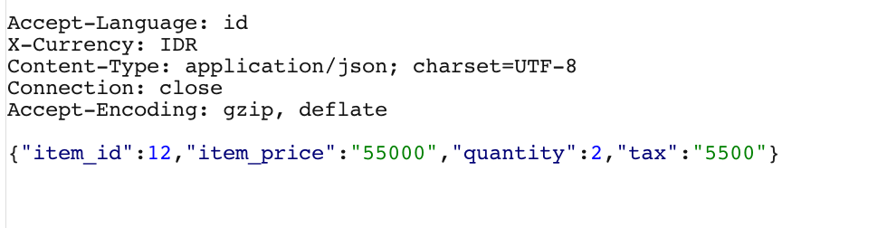
example
You must pay : 115500

Slide 30
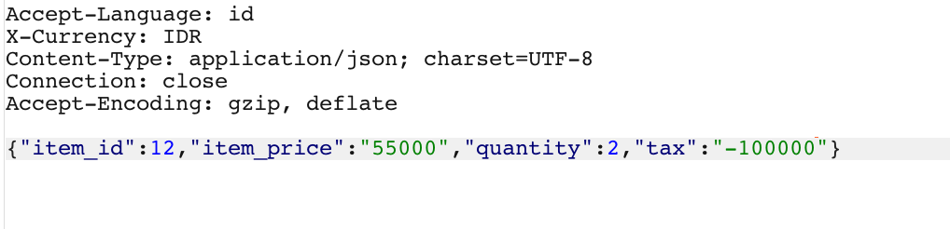
example
You must pay : 10000

Slide 31
SQL Injection
SQL injection usually occurs when you ask a user for input, like their username/userid, and instead of a name/id, the user gives you an SQL statement that you will unknowingly run on your database.
IMPACT
Attacker could dump database information such as users, credit card and the others.
Attacker could modify the existing database

Slide 32
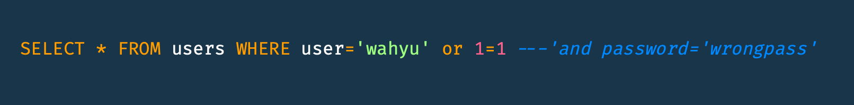
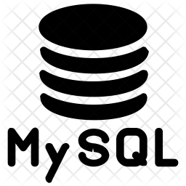
SQL Injection - How it Works ???
/login
username=wahyu’ or 1=1 --&password=wrongpass
Login Success
true

Slide 33
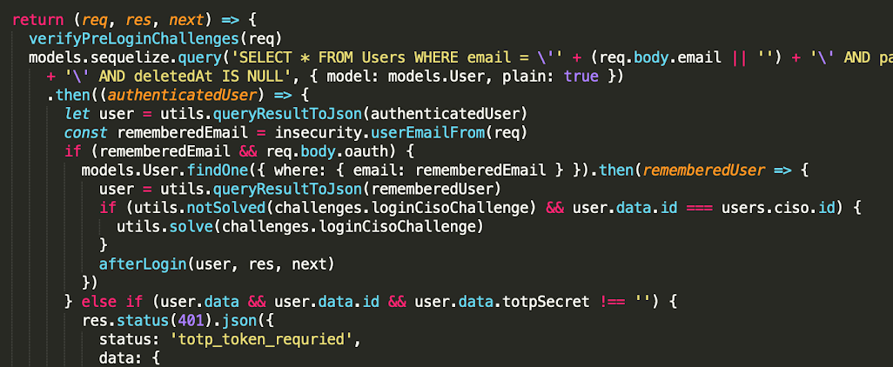
Sql InjectionExample in Node JS

Slide 34
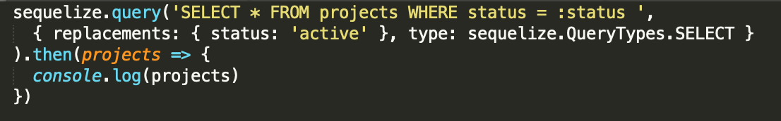
Mitigation Sql Injection in Node JS
Use Replacements query in sequelizejs ORM, to escape the user input before being executed by SQL Query

Slide 35
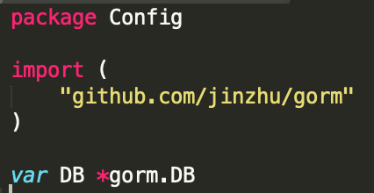
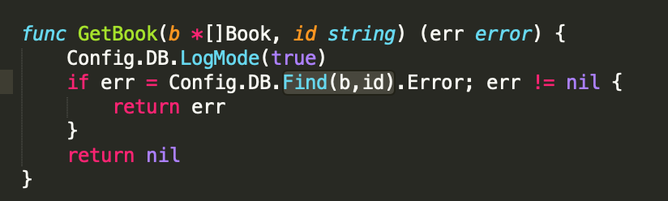
Sql Injection In GORM (CVE-2019-15562)

Slide 36
Traversal
allowed to access other files that are not in the web root directory of the server. Thus, the server is vulnerable to directory traversal attack

Slide 37
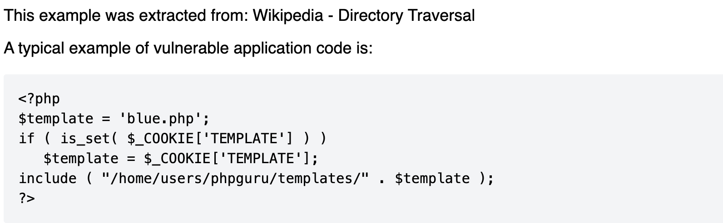

Slide 38
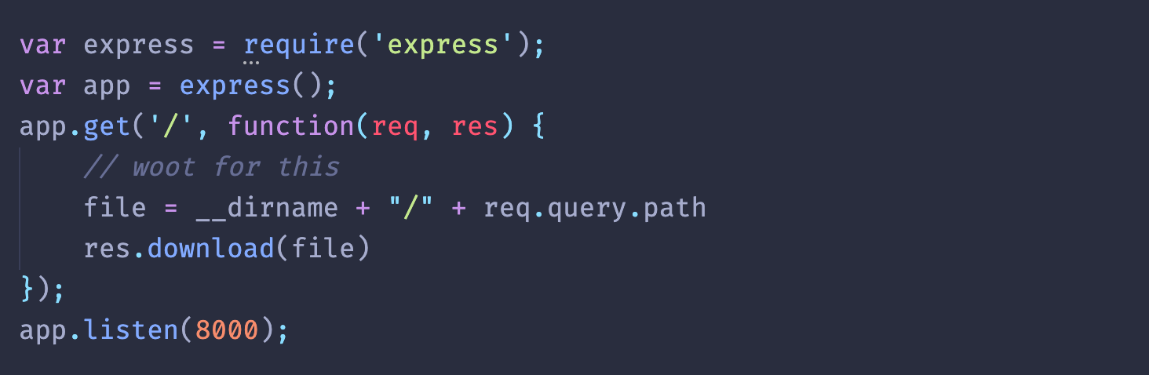

Slide 39
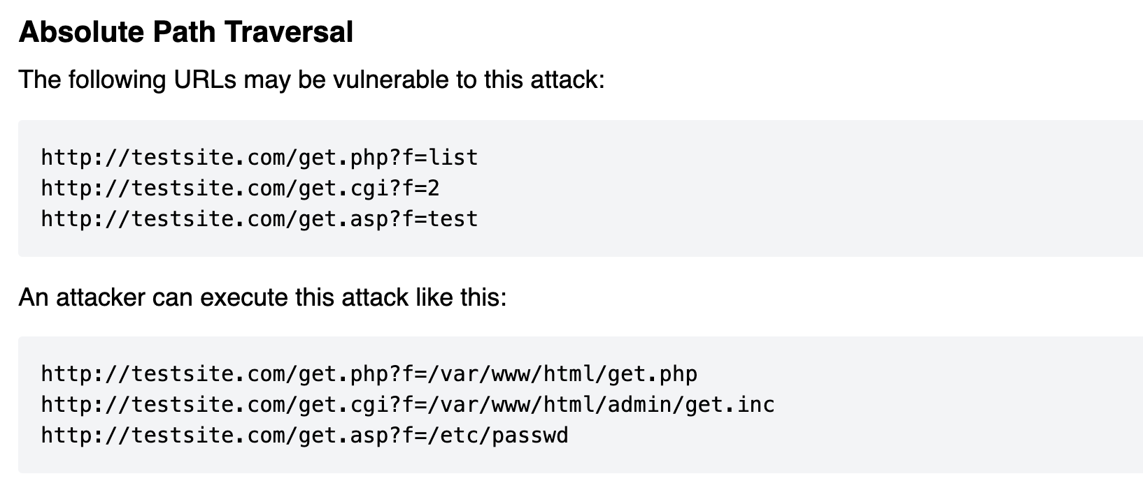

Slide 40
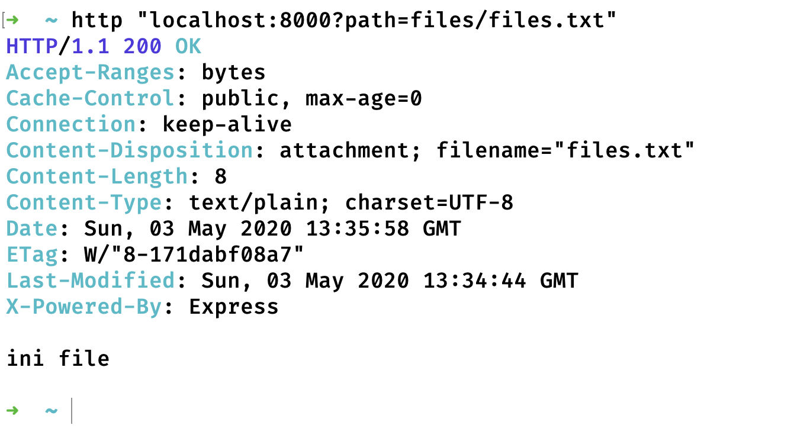

Slide 41
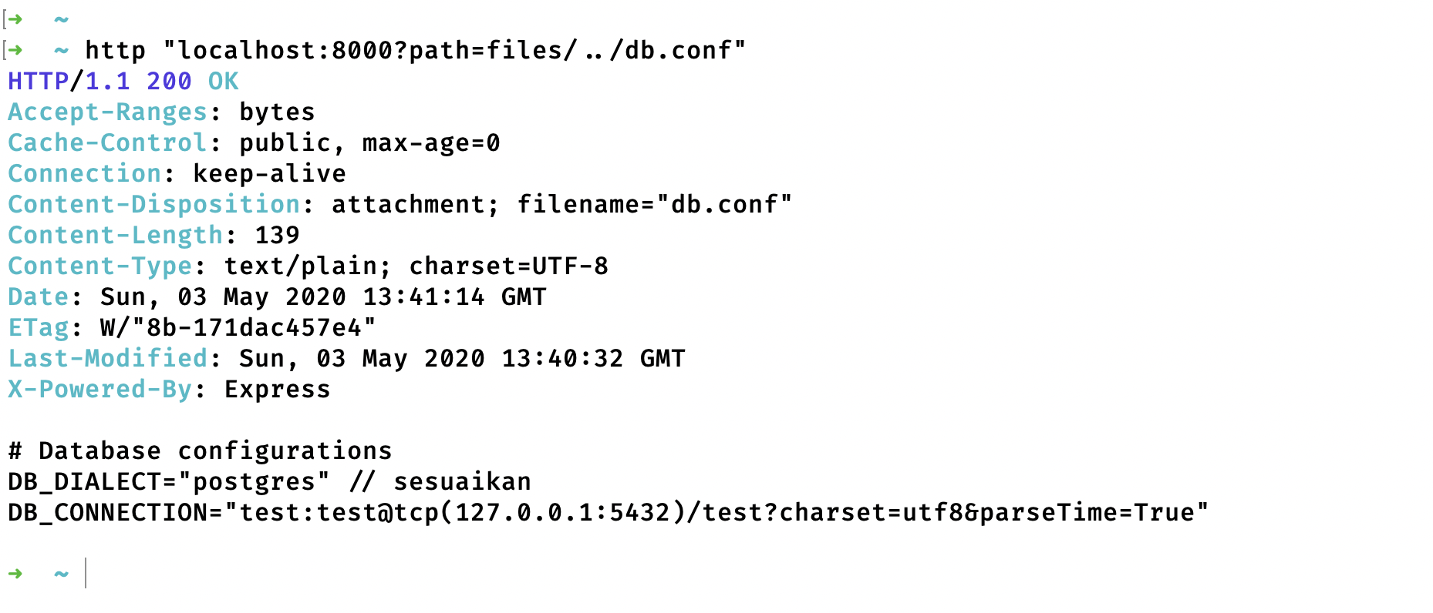

Slide 42
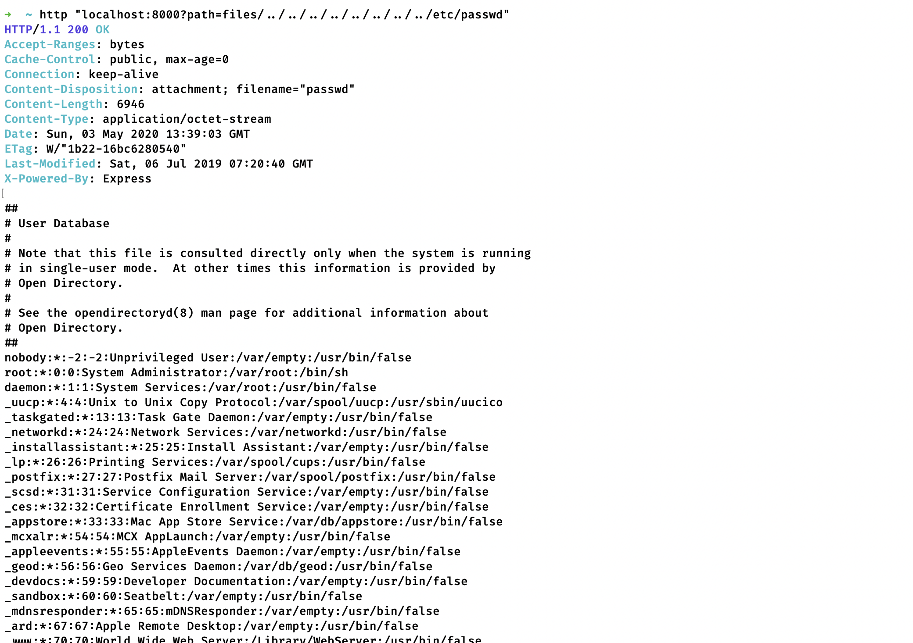

Slide 43
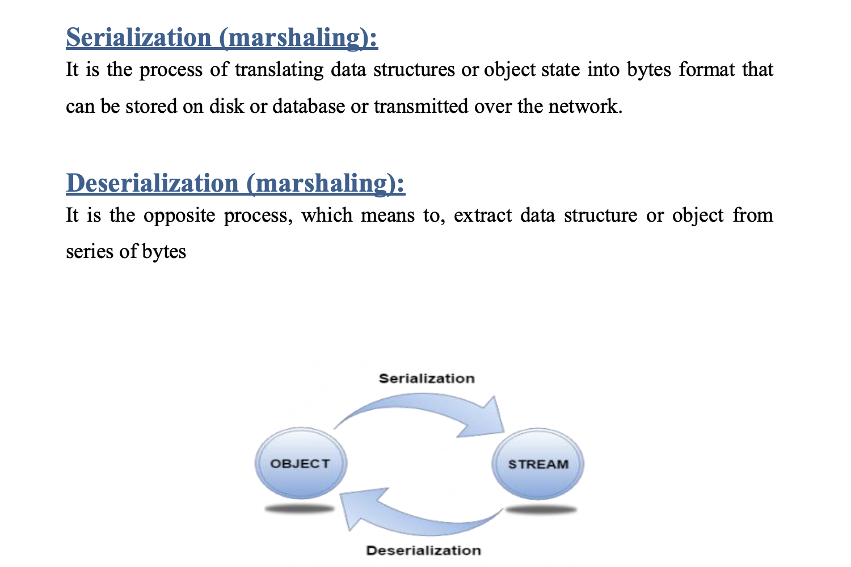
Json Deserialization Exploitation

Slide 44
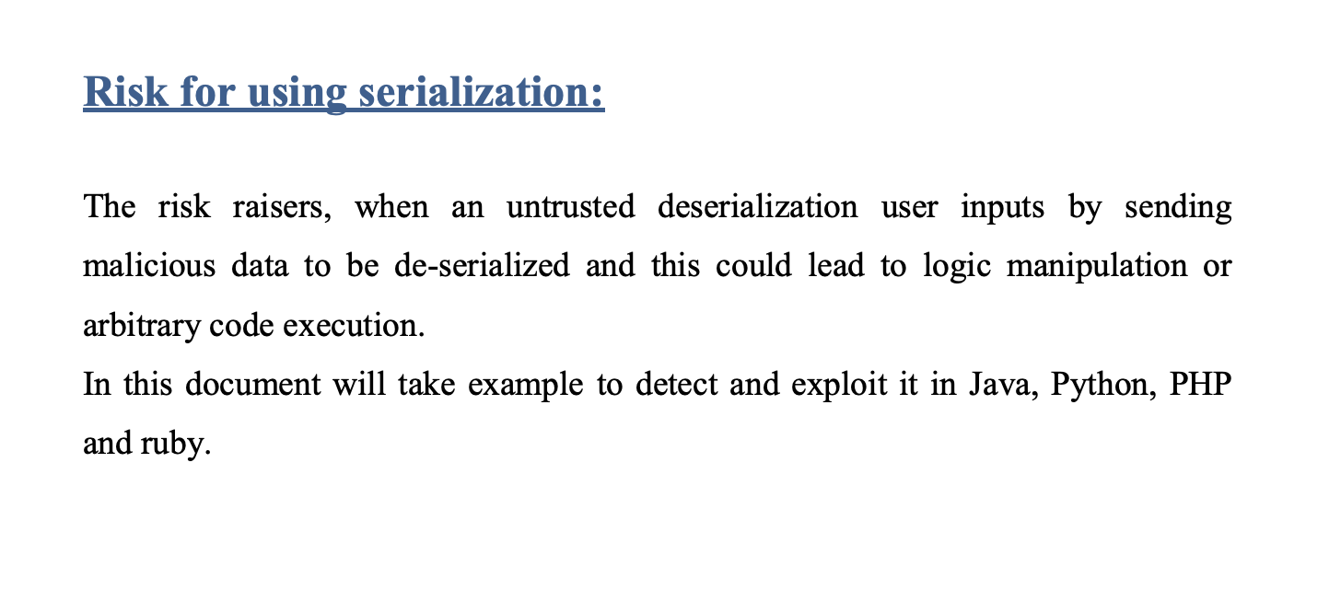

Slide 45
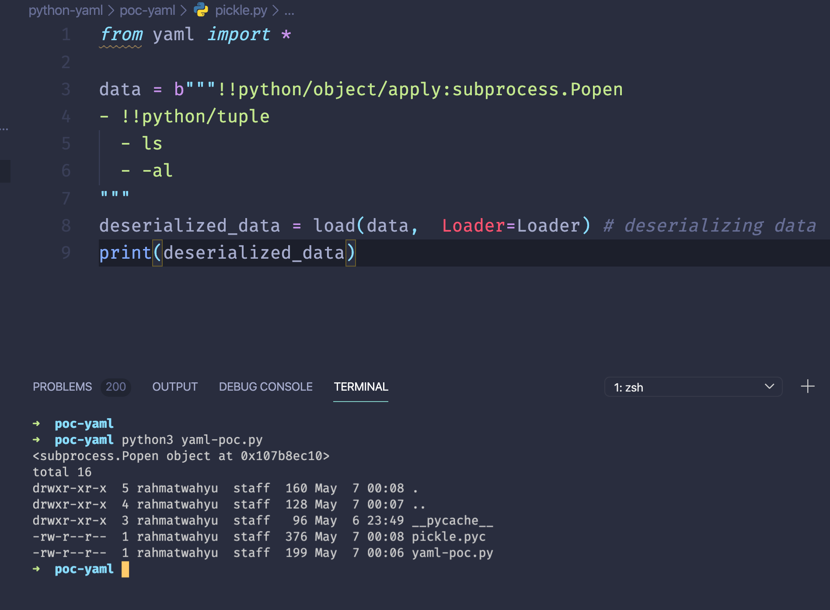
Example in python

Slide 46
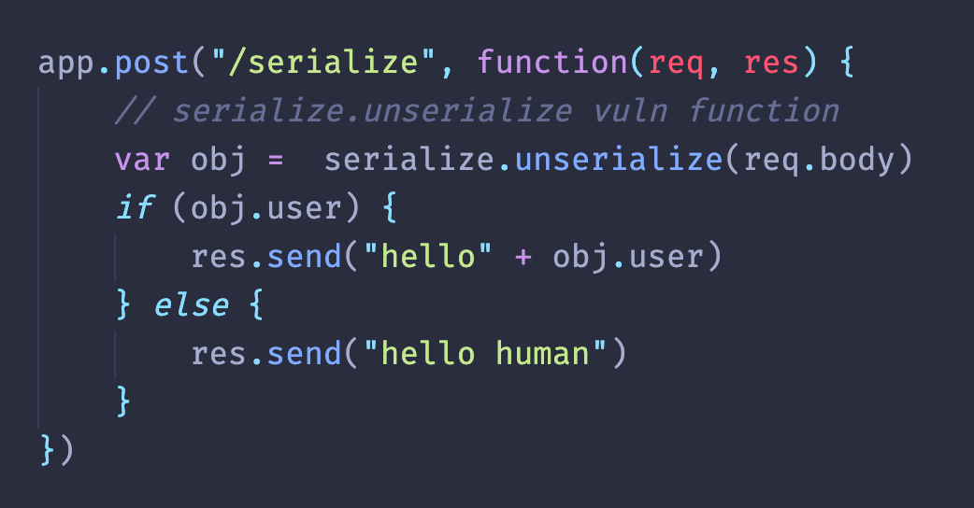
Example in Nodejs

Slide 47
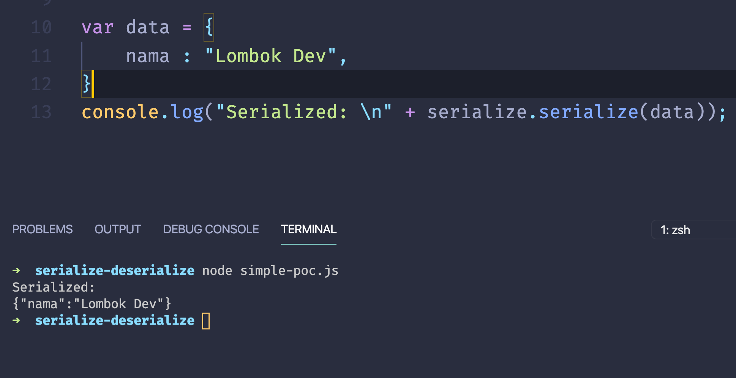
Simple POC

Slide 48
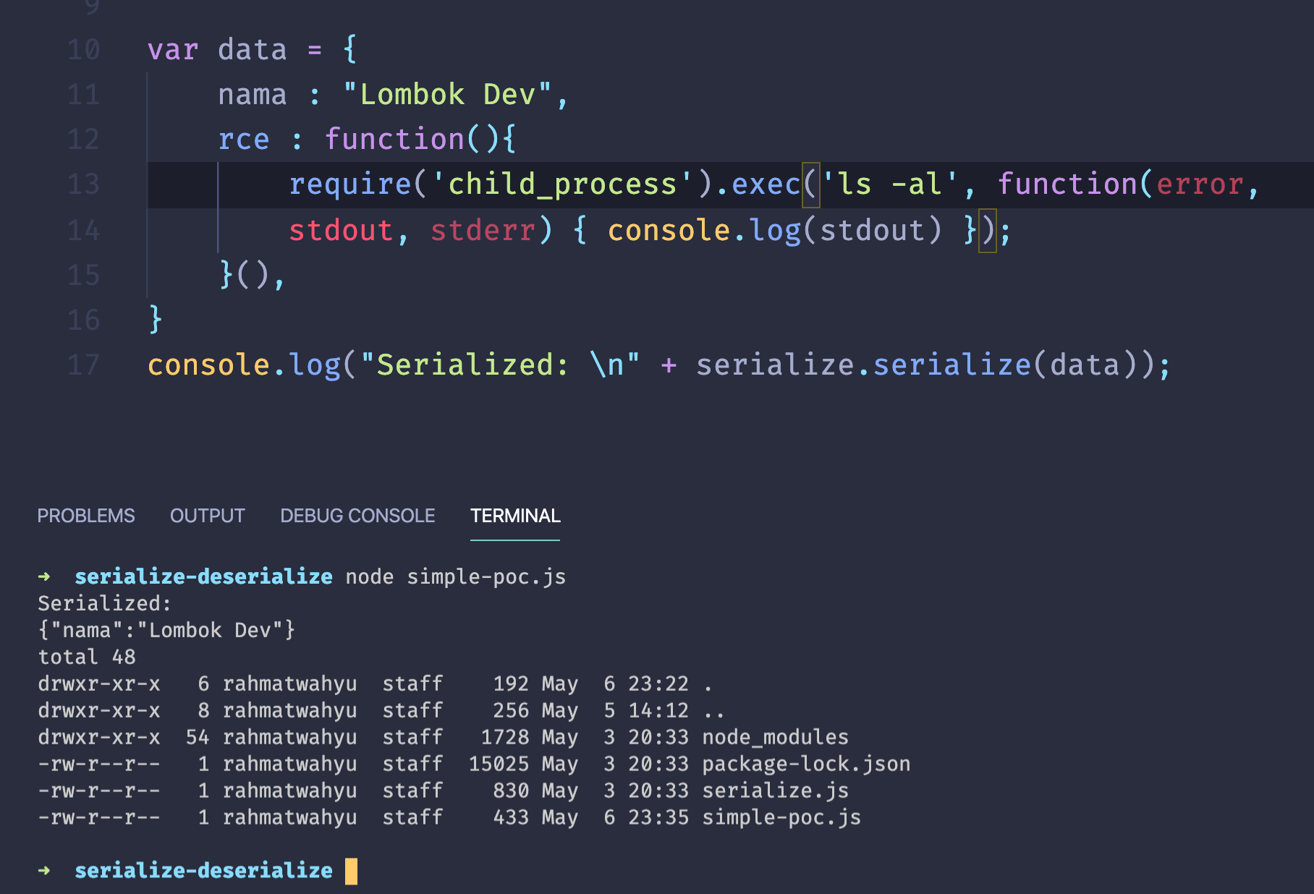
Add Payload

Slide 49
https://github.com/wahyuhadi/lombov-dev-sharing

